Slide 1
Design and Analysis of Algorithms
CS602
Lecture 13
A new algorithm paradigm
Dynamic Programming

Slide 2
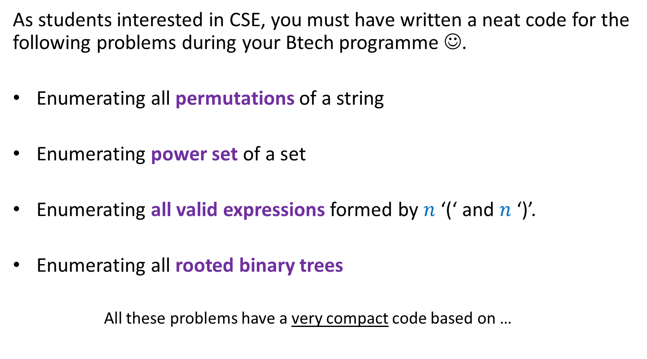
Recursion
As students interested in CSE, you must have written a neat code for the following problems during your Btech programme ☺.
Enumerating all permutations of a string
Enumerating power set of a set
Enumerating all valid expressions formed by $n$ ‘(‘ and $n$ ‘)’.
Enumerating all rooted binary trees
All these problems have a very compact code based on …

Slide 3
Revisiting a problem from your past
you solved using recursion

Slide 4
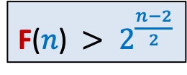
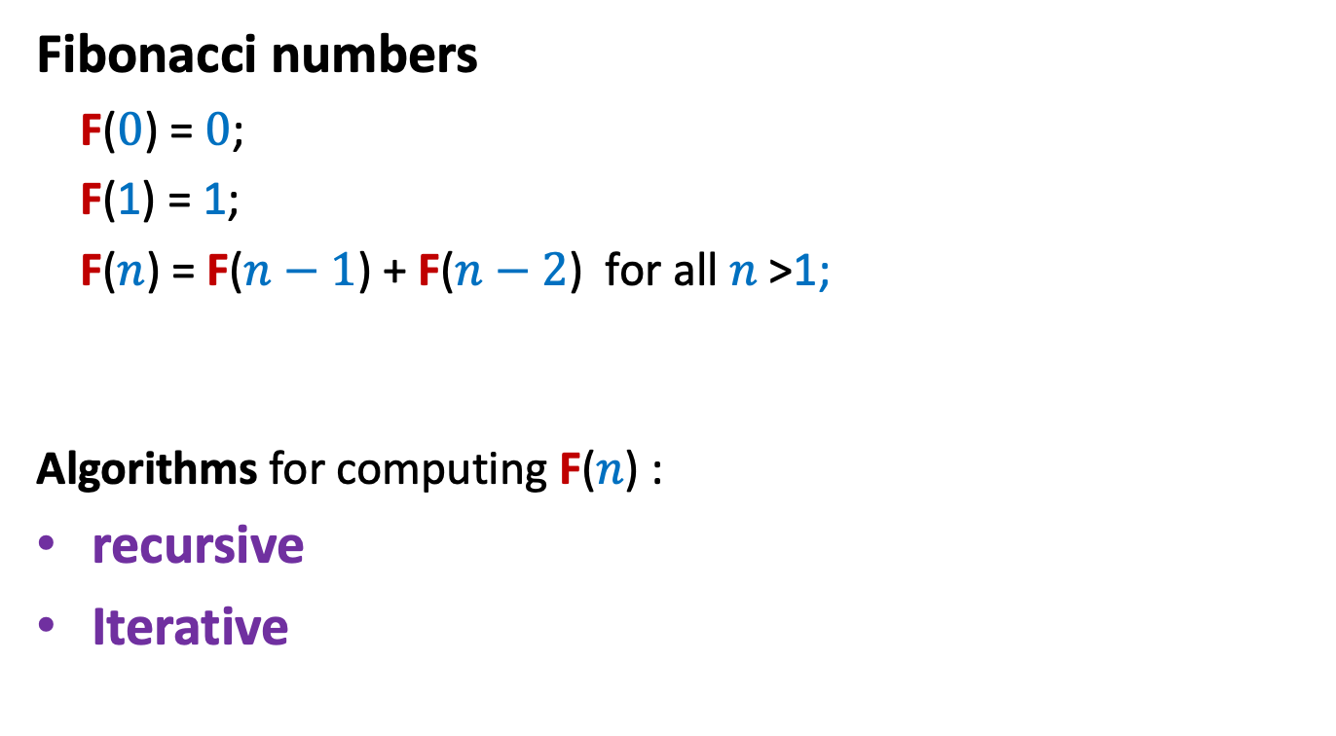
Fibonacci numbers
Fibonacci numbers
F($0$) = $0$;
F(1) = 1;
F($n$) = F($n−1$) + F($n−2$) for all $n$ >1;
Algorithms for computing F($n$) :
recursive
Iterative
F($n$) $> 2^{\frac{n−2}{2}}$

Slide 5



Recursive algorithm for F($n$)
Rfib($n$)
{
if $n=0$return $0$;
else if $n=1$return $1$;
else return( Rfib($n−1$) $+$ Rfib($n−2$) )
}
Real time to run for $n=1000$ ?
Hours, days, months …
Let us look at its recursion tree to find the exact cause of its inefficiency.

Slide 6















Recursive algorithm for F($n$)
Recursion tree
The algorithm computes
$\text{F}$($n−2$)
$\text{F}$($n−3$)
…
$\text{F}$($1$)
$\text{Rfib}$($n$)
$2$ times
$3$ times
$\text{Rfib}$($n−1$)
$\text{Rfib}$($n−2$)
$\text{F}$($n$) times
$\text{Rfib}$($n−3$)
$\text{Rfib}$($n−4$)
$\text{Rfib}$($n−2$)
$\text{Rfib}$($n−3$)
Let us have a table to avoid this recomputation.
F($n$) = F($n−1$) + F($n−2$)
$\text{Rfib}$($n−3$)
$\text{Rfib}$($n−4$)
F
Are you able to locate the cause of inefficiency of the recursive algorithm ?
0 1
0 | 1 | 2 | …
$$i$$

Slide 7



Iterative Algorithm for F($n$)
IFib($n$)
if $n$=0 return 0;
else if $n$=1 return 1;
else { a ← 0; b← 1;
For($i$=2 to $n$) do
{ temp ← b;
b← a+b;
a← temp;
}
}
return b;
F
0 1
0 | 1 | 2 | …
$$i$$

Slide 8
Longest common subsequence

Slide 9








What is a subsequence ?
sequence $A$ : $a_{1}$, $a_{2}$,…, $a_{n}$
Can be stored in an array $A[1..n]$,
$A[j]$ : ?
Definition: $C$ is said to be a subsequence of $A$ if
we can obtain $C$ by removing $0$ or more elements from $A$.
Example: $A$ : $a,b,a,d,e,b,c,a$
$C$ : $a,a,e,b,a$
There exists $m$ integers: $i_{1}<i_{2}…<i_{m}$
such that for all $1≤j≤m$, ?
$$a_{j}$$
$A[1..k]$ : ?
$a_{1}$, $a_{2}$,…, $a_{k}$
A more formal definition ?
$$C[1..m]$$
$$1≤$$
$$≤n$$
$A[i_{j}]=C\left[j\right]$

Slide 10
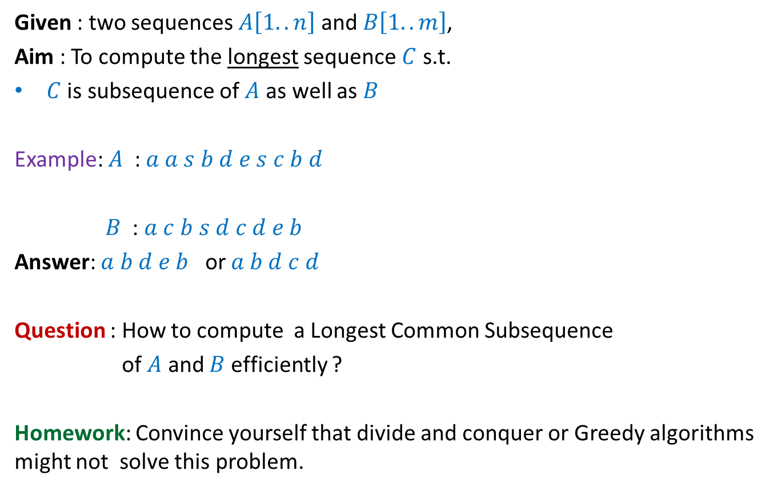
Problem Definition
Given : two sequences $A\left[1..n\right]$ and $B\left[1..m\right]$,
Aim : To compute the longest sequence $C$ s.t.
$C$ is subsequence of $A$ as well as $B$
Example: $A$ : $a a s b d e s c b d$
$B$ : $a c b s d c d e b$
Answer: $a b d e b$ or $a b d c d$
Question : How to compute a Longest Common Subsequence
of $A$ and $B$ efficiently ?
Homework: Convince yourself that divide and conquer or Greedy algorithms might not solve this problem.

Slide 11
Observations

Slide 12


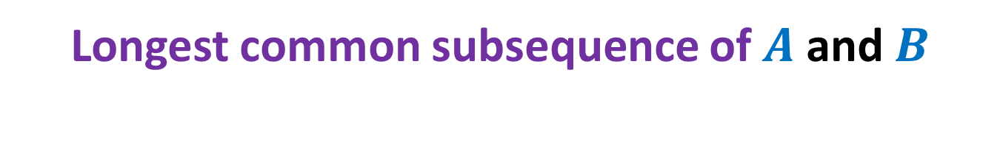



Longest common subsequence of $A$ and $B$
An element of $A$ may be matched with many elements of $B$.
Where to start from ☹
$a_{1}$ $a_{2}$ $a_{3}$ … $a_{n−1}{ a}_{n}$
$$A$$
$$B$$
$b_{1}$ $b_{2}$ $b_{3}$ … $b_{m−1}{ b}_{m}$

Slide 13


Longest common subsequence of $A$ and $B$
when $a_{n}=b_{m}$
$a_{1}$ $a_{2}$ $a_{3}$ … $a_{n−1}{ a}_{n}$
$$A$$
$$B$$
$b_{1}$ $b_{2}$ $b_{3}$ … $b_{m−1}{ b}_{m}$

Slide 14

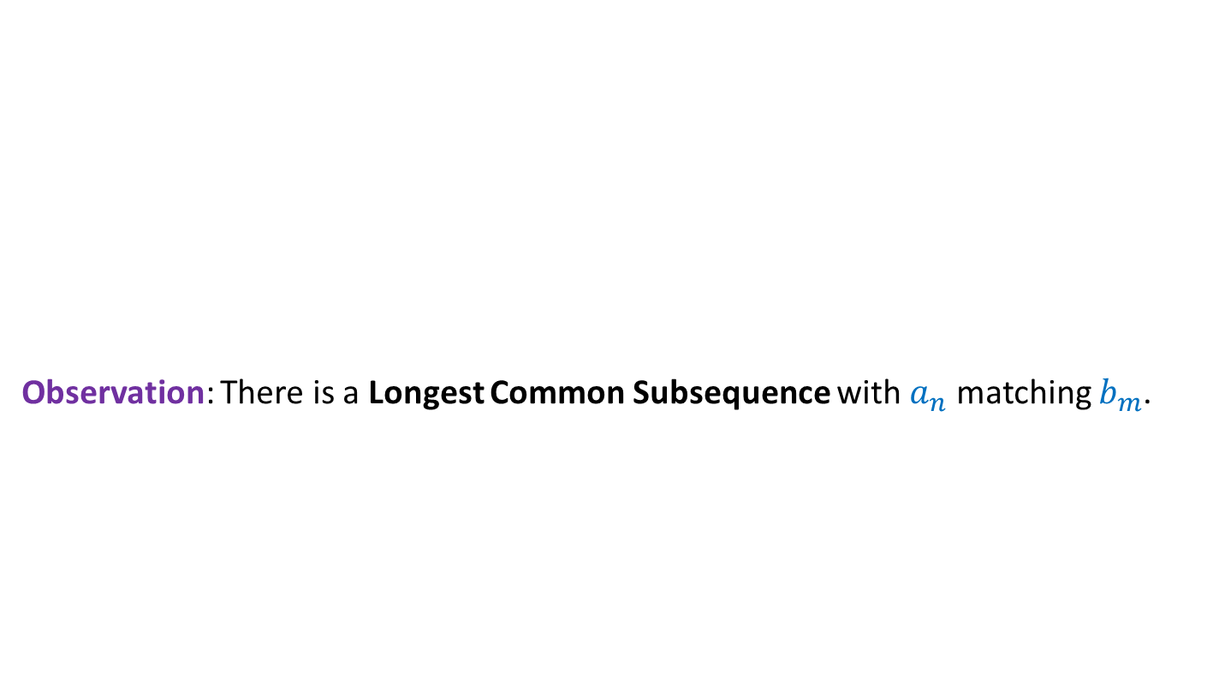


Longest common subsequence of $A$ and $B$
when $a_{n}=b_{m}$
Observation: There is a Longest Common Subsequence with $a_{n}$ matching $b_{m}$.
Otherwise, $b_{m}$ is matched with $a_{i}$ for some $i<n$. Since $b_{m}$ is the last symbol of $B$, we can as well match $b_{m}$ with $a_{n}$ to get the desired LCS.
Otherwise, we can append $a_{n}$ at the end of such LCS to get a longer LCS.
A contradiction !
$a_{1}$ $a_{2}$ $a_{3}$ … $a_{n−1}{ a}_{n}$
$$A$$
$$B$$
$b_{1}$ $b_{2}$ $b_{3}$ … $b_{m−1}{ b}_{m}$
Last symbol of Longest Common Subsequence must be $a_{n}$.
We can even make a stronger observation.
What kind of picture emerge for the LCS in this case ?

Slide 15


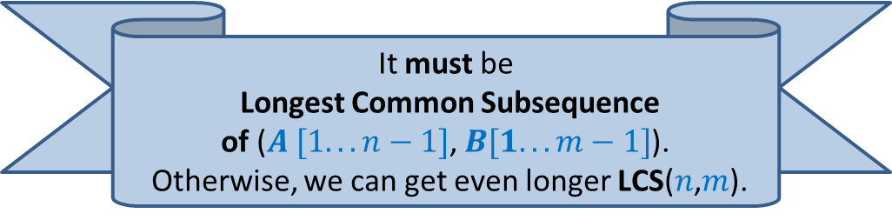

Longest common subsequence of $A$ and $B$
when $a_{n}=b_{m}$
Observation: There is a Longest Common Subsequence with $a_{n}$ matching $b_{m}$.
Lemma: If $a_{n}=b_{m}$then
Longest Common Subsequence =
?
$a_{1}$ $a_{2}$ $a_{3}$ … $a_{n−1}{ a}_{n}$
What can you say about the Longest Common Subsequence excluding the last (red) symbol ?
$$A$$
$$B$$
$b_{1}$ $b_{2}$ $b_{3}$ … $b_{m−1}{ b}_{m}$
LCS($n$,$m$)
LCS($n−1$,$m−1$) ::${ a}_{n}$
Longest Common Subsequence of $A [1…n−1]$, $B[1…m−1]$::${ a}_{n}$
It must be
Longest Common Subsequence
of ($A [1...n−1]$, $B[1.. . m−1]$).
Otherwise, we can get even longer LCS($n$,$m$).
LCS($i$, $j$): Longest common subsequence of $A\left[1..i\right]$ and $B\left[1..j\right]$

Slide 16

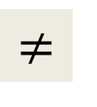
Longest common subsequence of $A$ and $B$
when $a_{n}=b_{m}$
$$≠$$
Observation: Either $a_{n}$or $b_{m}$is not the last symbol of LCS($n$,$m$).
Observation: If $a_{n}$is not the last symbol of LCS($n$,$m$)
$a_{1}$ $a_{2}$ $a_{3}$ … $a_{n−1}{ a}_{n}$
$$A$$
$$B$$
$b_{1}$ $b_{2}$ $b_{3}$ … $b_{m−1}{ b}_{m}$

Slide 17

Longest common subsequence of $A$ and $B$
when $a_{n}=b_{m}$
$$≠$$
Observation: Either $a_{n}$or $b_{m}$is not the last symbol of LCS($n$,$m$).
Observation: If $a_{n}$is not the last symbol of LCS($n$,$m$)
$a_{1}$ $a_{2}$ $a_{3}$ … $a_{n−1}{ a}_{n}$
$$A$$
$$B$$
$b_{1}$ $b_{2}$ $b_{3}$ … $b_{m−1}{ b}_{m}$

Slide 18


Longest common subsequence of $A$ and $B$
when $a_{n}=b_{m}$
$$≠$$
Observation: Either $a_{n}$or $b_{m}$is not the last symbol of LCS($n\text{,}m$).
Observation: If $a_{n}$is not the last symbol of LCS($n$,$m$)
➔ LCS($n$,$m$) is ?
$a_{1}$ $a_{2}$ $a_{3}$ … $a_{n−1}{ a}_{n}$
$$A$$
$$B$$
$b_{1}$ $b_{2}$ $b_{3}$ … $b_{m−1}{ b}_{m}$
LCS($n−1$,$m$)

Slide 19
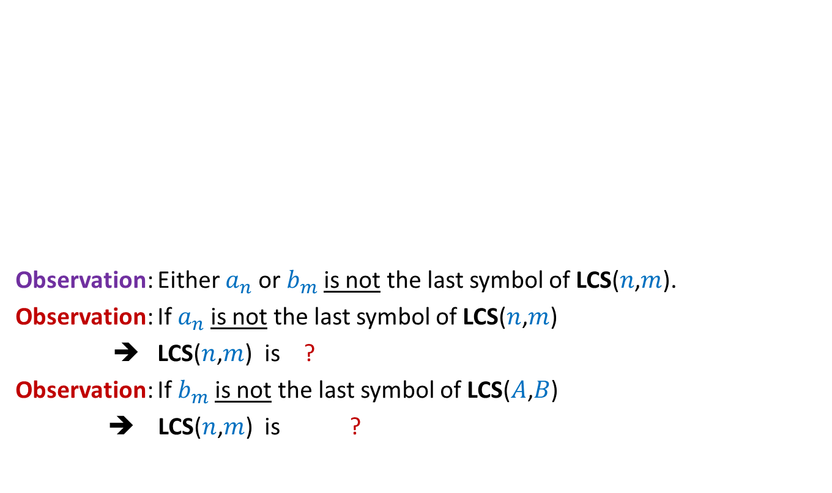

Longest common subsequence of $A$ and $B$
when $a_{n}=b_{m}$
$$≠$$
Observation: Either $a_{n}$or $b_{m}$is not the last symbol of LCS($n\text{,}m$).
Observation: If $a_{n}$is not the last symbol of LCS($n$,$m$)
➔ LCS($n$,$m$) is ?
Observation: If $b_{m}$is not the last symbol of LCS($A$,$B$)
➔ LCS($n$,$m$) is ?
$a_{1}$ $a_{2}$ $a_{3}$ … $a_{n−1}{ a}_{n}$
$$A$$
$$B$$
$b_{1}$ $b_{2}$ $b_{3}$ … $b_{m−1}{ b}_{m}$
LCS($n−1$,$m$)
LCS($n$,$m−1$)

Slide 20

Longest common subsequence of $A$ and $B$
when $a_{n}=b_{m}$
$$≠$$
Observation: Either $a_{n}$or $b_{m}$is not the last symbol of LCS($n$,$m$).
Lemma: If $a_{n}≠b_{m}$then
LCS($n\text{,}m$) is either LCS($n$,$m−1$) or LCS($n−1$,$m$)
$a_{1}$ $a_{2}$ $a_{3}$ … $a_{n−1}{ a}_{n}$
$$A$$
$$B$$
$b_{1}$ $b_{2}$ $b_{3}$ … $b_{m−1}{ b}_{m}$

Slide 21
Recursive formulation
LCS($i$, $j$): Longest common subsequence of $A\left[1..i\right]$ and $B\left[1..j\right]$

Slide 22
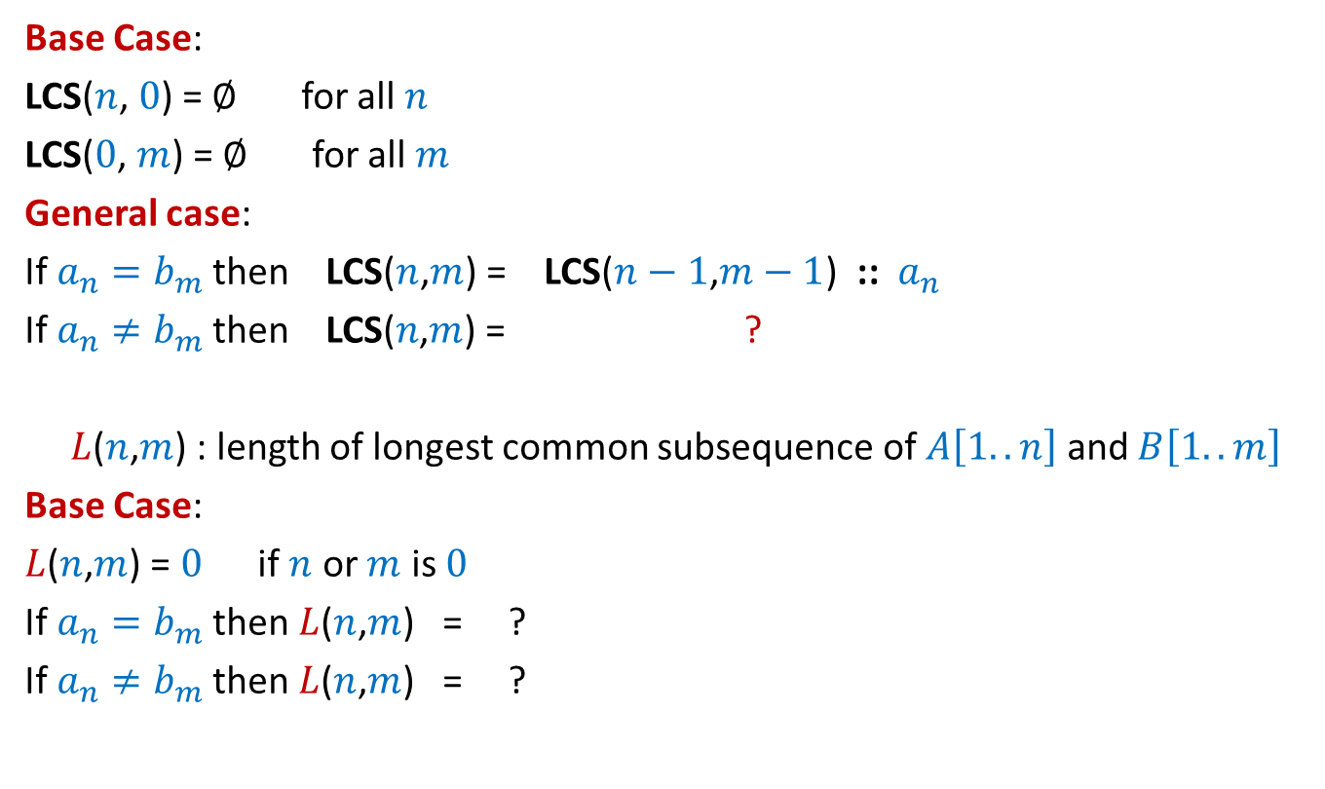
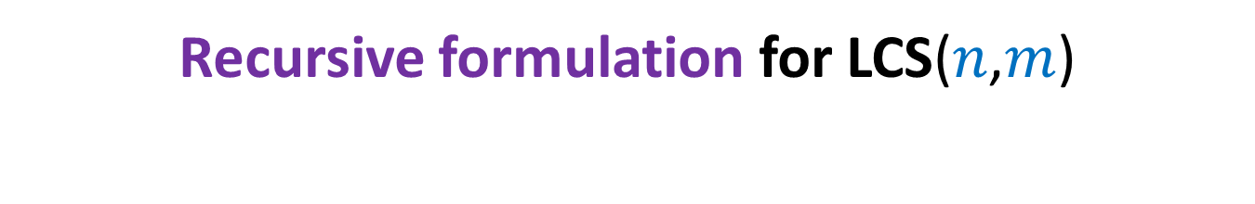



Recursive formulation for LCS($n$,$m$)
Base Case:
LCS($n$, $0$) = $∅$ for all $n$
LCS($0$, $m$) = $∅$ for all $m$
General case:
If $a_{n}=b_{m}$then LCS($n$,$m$) = LCS($n−1$,$m−1$) ::${ a}_{n}$
If $a_{n}≠b_{m}$then LCS($n\text{,}m$) = ?
$L$($n$,$m$) : length of longest common subsequence of $A\left[1..n\right]$ and $B\left[1..m\right]$
Base Case:
$L$($n$,$m$) = $0$ if $n$ or $m$ is $0$
If $a_{n}=b_{m}$then $L$($n$,$m$) = ?
If $a_{n}≠b_{m}$then $L$($n$,$m$) = ?
bigger of LCS($n$,$m−1$) or LCS($n−1$,$m$)
$L$($n−1$,$m−1$) + 1
Max( $L$($n−1$,$m$) , $L$($n$,$m−1$))

Slide 23
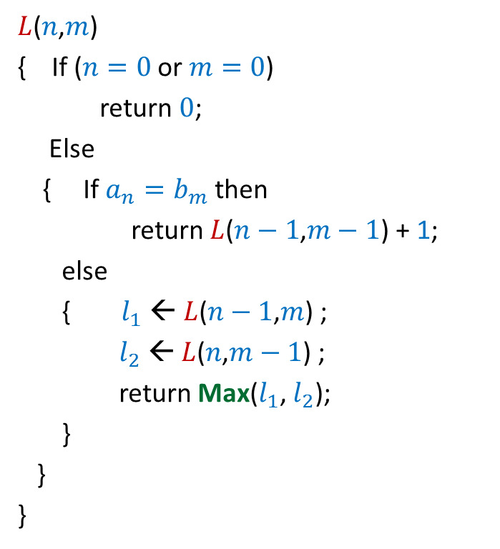

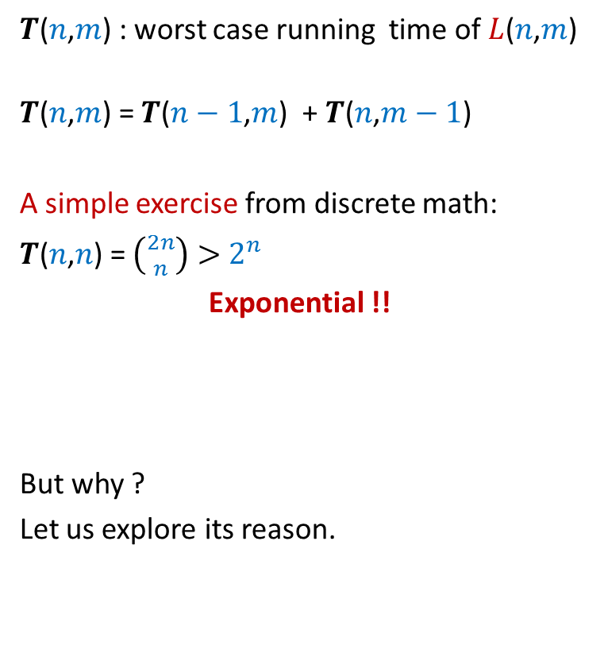
Recursive algorithm for $L$($n$,$m$)
$L$($n$,$m$)
{ If ($n=0$ or $m=0$)
return $0$;
Else
{ If $a_{n}=b_{m}$then
return $L$($n−1$,$m−1$) + 1;
else
{ $l_{1}$ ← $L$($n−1$,$m$) ;
$l_{2}$ ← $L$($n$,$m−1$) ;
return Max($l_{1}$, $l_{2}$);
}
}
}
$T$($n$,$m$) : worst case running time of $L$($n$,$m$)
$T$($n$,$m$) = $T$($n−1$,$m$) + $T$($n$,$m−1$)
A simple exercise from discrete math:
$T$($n$,$n$) = $\left({2n \atop n}\right)>$ $2^{n}$
Exponential !!
But why ?
Let us explore its reason.

Slide 24








Recursive algorithm for $L$($n$,$m$)
Recursion tree
$L$($n$,$m$)
$L$($n$,$m$)
{ If ($n=0$ or $m=0$)
return $0$;
Else
{ If $a_{n}=b_{m}$then
return $L$($n−1$,$m−1$) + 1;
else
{ $l_{1}$ ← $L$($n−1$,$m$) ;
$l_{2}$ ← $L$($n$,$m−1$) ;
return Max($l_{1}$, $l_{2}$);
}
}
}
Solving same sub-problem multiple times !!
But how many sub-problems are there ?
only ($n+1$)*($m+1$).
Can we compute them efficiently ?
$L$($n−1$,$m$)
$L$($n$,$m−1$)
$L$($n−1$,$m−1$)
$L$($n$,$m−2$)
$L$($n−2$,$m$)
$L$($n−1$,$m−1$)
The answer lies in the exercise on Fibonacci numbers we did in the beginning of this lecture. ☺

Slide 25









Recursive algorithm for $F$($n$)
Recursion tree
$F$($n$)
$F$($n−1$)
$F$($n−2$)
$F$($n−3$)
$F$($n−4$)
$F$($n−2$)
$F$($n−3$)
F
0 1
0 | 1 | 2 | …
$$i$$

Slide 26







Recursive algorithm for $L$($n$,$m$)
$T$[$i$,$j$] = $L$($i$,$j$)
$L$($n$,$m$)
{ If ($n=0$ or $m=0$)
return $0$;
Else
{ If $a_{n}=b_{m}$then
return $L$($n−1$,$m−1$) + 1;
else
{ $l_{1}$ ← $L$($n−1$,$m$) ;
$l_{2}$ ← $L$($n$,$m−1$) ;
return Max($l_{1}$, $l_{2}$);
}
}
}
$$n$$
0
$$i$$
…
…
1
0
0
0 0 0 ... 0
0 1 ... $m$
$$j$$
$$T$$

Slide 27
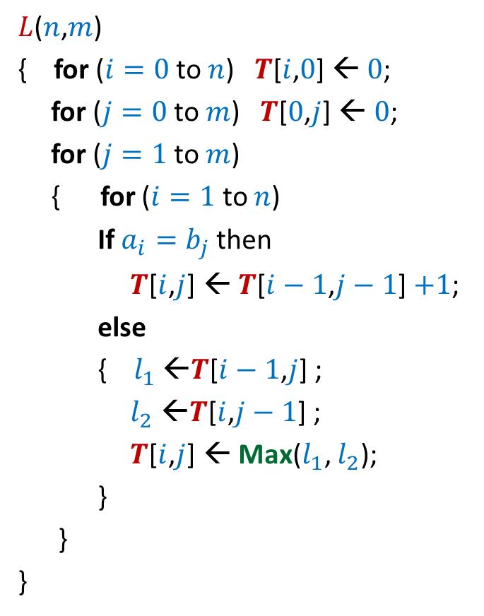


Iterative algorithm for $L$($n$,$m$)
$L$($n$,$m$)
{ for ($i=0$ to $n$) $T$[$i$,$0$] ← $0$;
for ($j=0$ to $m$) $T$[$0$,$j$] ← $0$;
for ($j=1$ to $m$)
{ for ($i=1$ to $n$)
If $a_{i}=b_{j}$then
$T$[$i$,$j$] ← $T$[$i−1$,$j−1$] $+1$;
else
{ $l_{1}$ ←$T$[$i−1$,$j$] ;
$l_{2}$ ←$T$[$i$,$j−1$] ;
$T$[$i$,$j$] ← Max($l_{1}$, $l_{2}$);
}
}
}
$$n$$
0
$$i$$
…
…
1
0
0
0 0 0 ... 0
0 1 ... $m$
$$j$$
Time complexity: O($nm$)
$$T$$

Slide 28
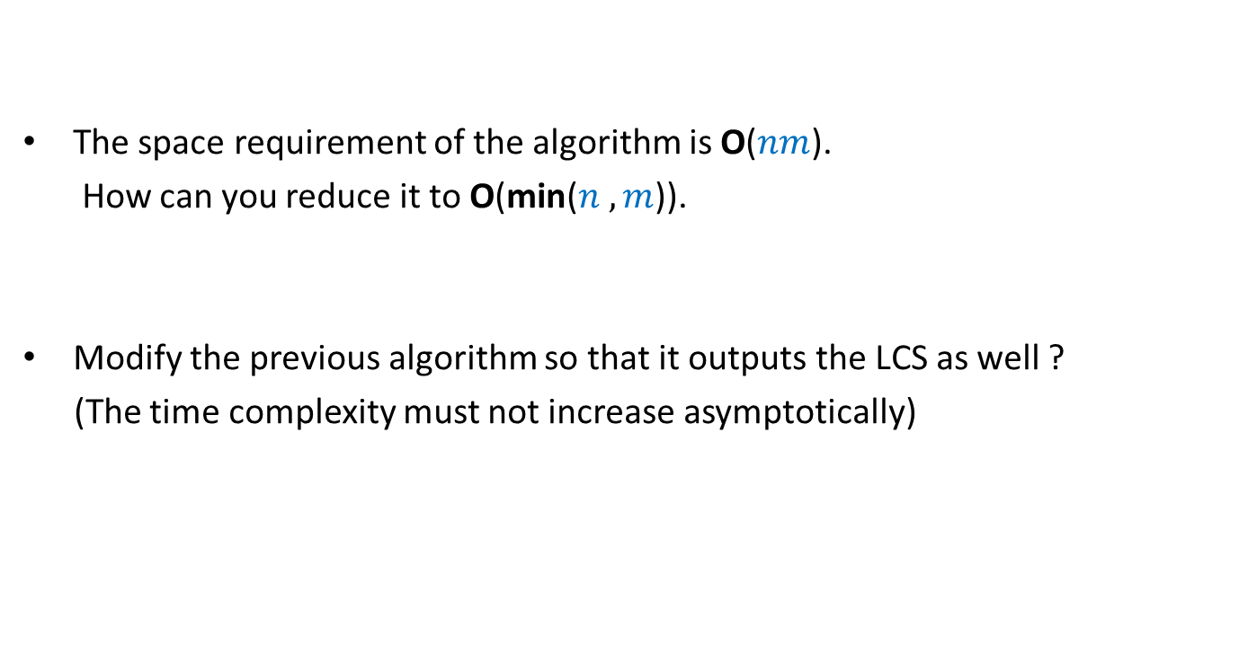
Homework
The space requirement of the algorithm is O($nm$).
How can you reduce it to O(min($n ,m$)).
Modify the previous algorithm so that it outputs the LCS as well ?
(The time complexity must not increase asymptotically)

Slide 29
Dynamic Programming algorithm paradigm
Expressing the solution recursively.
Overall there are only Polynomial number of subproblems.
But there is a huge overlap among the subproblems.
➔ So the recursive algorithm takes exponential time
(solving same subproblem multiple times).
So we compute the recursive solution iteratively in a bottom-up fashion
(like in case of Fibonacci numbers).
This avoids wastage of computation and leads to efficient implementation.

Slide 30
Steps of dynamic programming based algorithm
Recursive Formulation
Recursive Algorithm
Exponential time
Cause:
Overlap in subProblems
Polynomial no. of distinct subproblems
Bottom up approach to compute solution
A Polynomial time algorithm

Slide 31
OPTMAL Triangulation of a CONVEX POLYGON

Slide 32












Convex polygon
Representation: ?
How to store: ?
< $p_{i}$,…, $p_{j}$> : ?
< $p_{1}$,…, $p_{n}$>
Array
$$p_{i}$$
$$q$$
$$p_{n−2}$$
$$p_{3}$$
$$r$$
$$p_{2}$$
$$p_{n−1}$$
$$p_{n}$$
$$p_{1}$$
Polygon consisting of points $p_{i}$,…, $p_{j}$

Slide 33
Triangulation of a CONVEX POLYGON
Partitioning the polygon into disjoint triangles
$$p_{i}$$
$$p_{3}$$
$$p_{2}$$
$$p_{n−1}$$
$$p_{n}$$
$$p_{1}$$
, each defined by 3 points on the polygon

Slide 34
Triangulation of a CONVEX POLYGON
Partitioning the polygon into disjoint triangles
$$p_{i}$$
$$p_{3}$$
$$p_{2}$$
$$p_{n−1}$$
$$p_{n}$$
$$p_{1}$$
, each defined by 3 points on the polygon

Slide 35


Triangulation of a CONVEX POLYGON
Though there may be many triangulations,
but each has exactly
$n−2$ triangles.
Each side of the polygon
belongs to exactly $1$ triangle in a triangulation.
$$p_{i}$$
$$p_{3}$$
$$p_{2}$$
$$p_{n−1}$$
$$p_{n}$$
$$p_{1}$$

Slide 36
OPTMAL Triangulation of a CONVEX POLYGON

Slide 37


$ω$($i$,$j$,$k$) : weight of triangle formed by $p_{i}$, $p_{j}$, $p_{k}$.
Assumption: It takes O(1) time to compute $ω$($i$,$j$,$k$)
Cost of a triangulation : sum of the weight of $n−2$ triangles formed.
Aim: Compute triangulation of minimum cost.
$$p_{i}$$
$$p_{3}$$
$$p_{2}$$
$$p_{n−1}$$
$$p_{n}$$
$$p_{1}$$

Slide 38
Homework
Make sincere attempts to design a recursive formulation for the problem mentioned in the previous slide.

